Slide 1

Design and Implement Small Office Network Design

Slide 2
Our Team
SHR1_ISS2_S1e
Waleed Elshawadfy Abdallah
Yousef Mohamed Ebrahim
Mohamed Khaled Mohamed
Yasseen Ahmed Hasan
Mai Mohamed Naguib

Slide 3

Outline
Abstract
Introduction
Network Design
Routing Configuration
Switching configuration
Inter-VLAN Routing
Security Measure
Quality of Service (QoS)
Monitoring and Management
Testing and Validation
Results and Evaluation
Conclusion
Future Work

Slide 4
1.Introduction
Background
Amidst the dynamic landscape of contemporary computer networks, the “Small Office Network Design" initiative addresses the pressing need for a resilient network infrastructure finely tuned to bolster the functionalities of an expanding company or business center. With the center's growth and relocation to a new facility, the strategic significance of network routing and switching takes center stage, playing a crucial role in guaranteeing smooth communication, streamlined data transfer, and dependable access to resources. This project concentrates on navigating the intricacies inherent in developing an efficient and forward-looking network, leveraging Cisco Packet Tracer. The endeavor closely aligns with the specific requirements and expansion strategies of the trading floor support center.
Objectives
The primary objectives of the " Small Office Network Design " initiative are clearly outlined to cater to the unique demands of the company's network infrastructure. The project aims to establish a hierarchical network model incorporating redundancy measures at every layer. It seeks to establish connections with a minimum of two Internet Service Providers (ISPs) to enhance internet reliability, deploy wireless networks tailored for specific departments, allocate distinct Virtual Local Area Networks (VLANs) and subnets to ensure secure communication, and configure routing protocols, security protocols, and advanced functionalities like Secure Shell (SSH) and Port Address Translation (PAT). By achieving these objectives, the project aims to develop a scalable, resilient, and forward-looking network infrastructure that not only fulfils current operational needs but also anticipates and accommodates the future growth and technological advancements of the company.

Slide 5
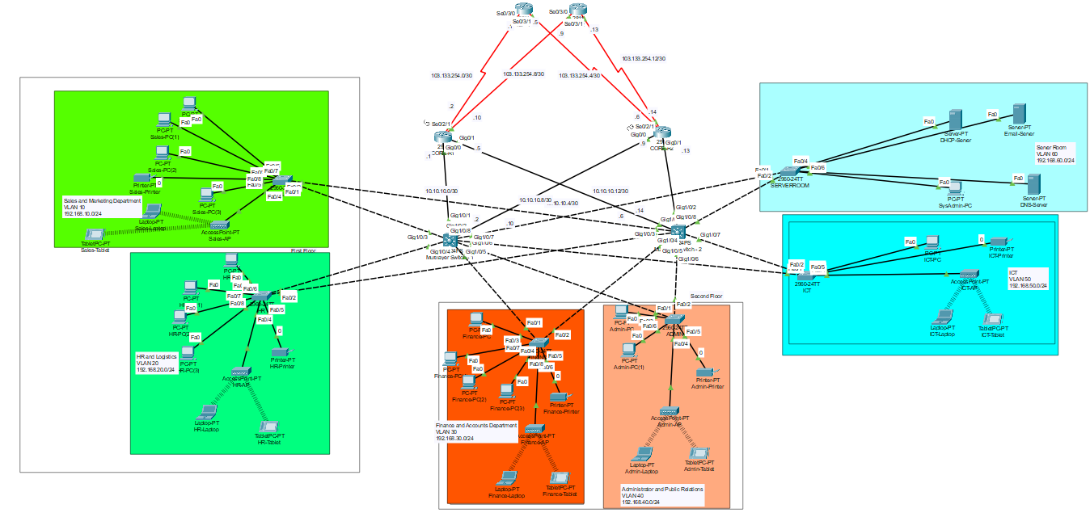
2.Network Design Topology

Slide 6

2.Network Design Components
1. Routers (4):
o 2 ISP router for upstream connectivity.
o Positioned at the core layer for redundancy.
o Connect to both ISPs for internet connectivity.
o Configured with static, public IP addresses from ISPs.
2. Multilayer Switches (2):
o Deployed at the core layer to provide redundancy and efficient routing.
o Configured for both switching and routing functionalities.
o Assigned IP addresses to enable inter-VLAN routing.
3. Distribution Layer Switches (Multiple):
o Connect individual departments to the core layer.
o Facilitate communication within respective VLANs.
4. End-User Devices (PCs):
o Deployed at the access layer.
o Connected to distribution layer switches for departmental access.
5. Cisco Access Points (APs):
o Positioned at the access layer to provide wireless connectivity.
o Ensure wireless network availability in each department
6. DHCP Servers (1):
Located in the server room.
o Dynamically allocate IP addresses to end-user devices.
7. Server Room Devices (Servers, etc.):
o DNS server, HTTP server etc.
o Devices in the server room are allocated static IP addresses.
o These devices may include servers, storage units, and networking equipment.

Slide 7
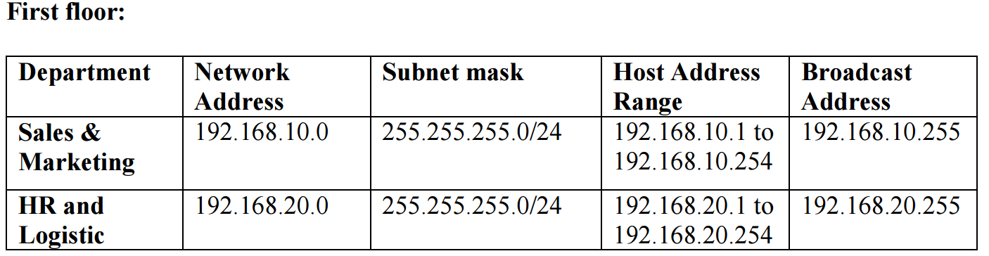
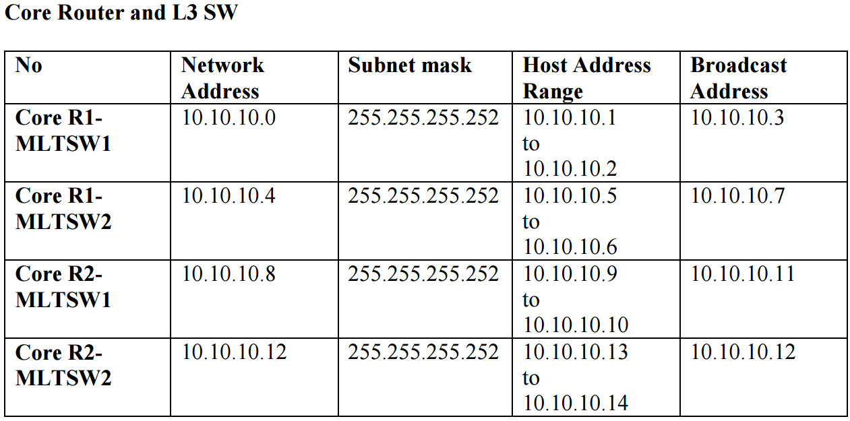
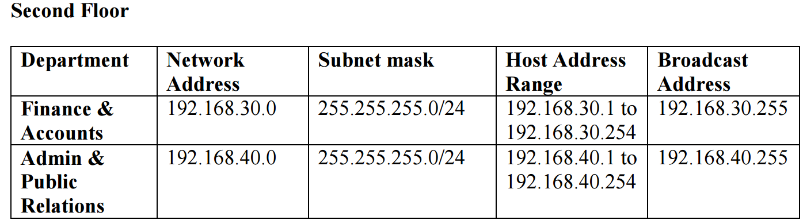
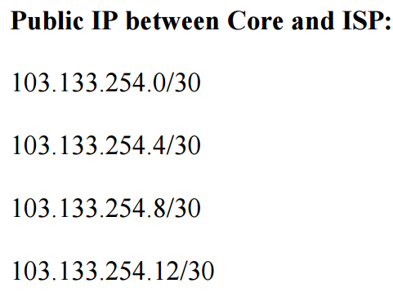
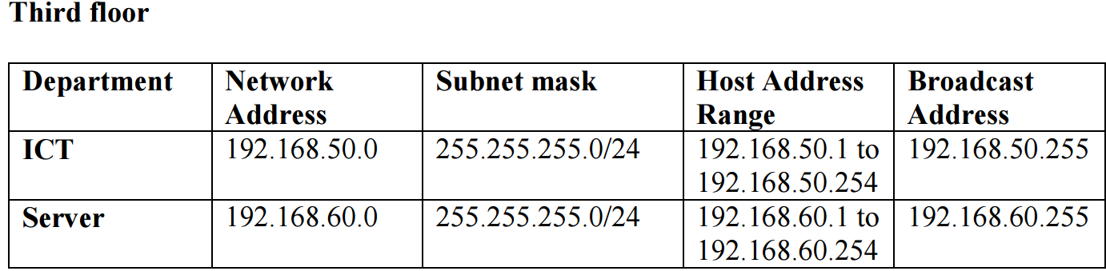
2.Network Design IP Addressing Scheme: Base Network: 192.168.0.0/22

Slide 8
3. Routing Configuration Router Configuration
Basic Router Configuration
conf t # Enters global configuration mode
hostname CORE-R2 # Sets the hostname to CORE-R2
line console 0 # Enters console line configuration mode
password cisco # Sets the console password to 'cisco'
login # Enables login on the console line
exit # Exits console line configuration mode
enable password cisco # Sets the enable password to 'cisco'
no ip domain-lookup # Disables DNS lookup for incorrectly entered commands
banner motd # NO Unauthorised Access!!!#
service password-encryption # Encrypts passwords in the configuration
do wr # Writes the configuration to memory
ip domain name cisco.net # Configures the domain name for DNS resolution
username admin password cisco # Creates a local user 'cisco' with password'cisco'
crypto key generate rsa # Generates an RSA key pair for SSH
1024 # Specifies the key size as 1024 bits
line vty 0 15 # Enters VTY line configuration mode
login local # Enables local authentication for VTY lines
transport input ssh # Allows SSH for remote access
ip ssh version 2 # Specifies the use of SSH version 2
do wr # Writes the configuration to memory
exit # Exits global configuration mode

Slide 9
3. Routing Configuration Static and Dynamic Routing
OSPF on L3 Switches and routers
L3:
ip routing
router ospf 10
router-id 2.2.2.2
network 192.168.10.0 0.0.0.255 area 0
network 192.168.20.0 0.0.0.255 area 0
network 192.168.30.0 0.0.0.255 area 0
network 192.168.40.0 0.0.0.255 area 0
network 192.168.50.0 0.0.0.255 area 0
network 192.168.60.0 0.0.0.255 area 0
network 10.10.10.0 0.0.0.3 area 0
network 10.10.10.8 0.0.0.3 area 0
core router:
router ospf 10
router-id 3.3.3.3
network 10.10.10.0 0.0.0.3 area 0
network 10.10.10.4 0.0.0.3 area 0
network 103.133.254.0 0.0.0.3 area 0
network 103.133.254.8 0.0.0.3 area 0
ISP:
router ospf 10
router-id 5.5.5.5
network 103.133.254.0 0.0.0.3 area 0
network 103.133.254.4 0.0.0.3 area 0
default routes on Routers
ip route 0.0.0.0 0.0.0.0 se0/2/0
ip route 0.0.0.0 0.0.0.0 se0/2/1 70
default routes on L3-SW
ip route 0.0.0.0 0.0.0.0 gig1/0/1
ip route 0.0.0.0 0.0.0.0 gig1/0/2 70
IP assignment on Core router interfaces
int gig0/0
ip address 10.10.10.1 255.255.255.252
no shutdown
int gig0/1
ip address 10.10.10.5 255.255.255.252
no shutdown
int se0/2/0
ip address 103.133.254.1 255.255.255.252
no shutdown
clock rate 64000
int se0/2/1
ip address 103.133.254.10 255.255.255.252
no shutdown
clock rate 64000
IP assignment on ISP router interfaces
int se0/3/0
ip address 103.133.254.1 255.255.255.252
no shutdown
int se0/3/1
ip address 103.133.254.5 255.255.255.252
no shutdown

Slide 10
4. Switch Configuration
4.1 Switch Configuration
======================
Basic SW configuration
======================
hostname Finance-SW
line console 0
password cisco
login
exit
enable password cisco
no ip domain-lookup
banner motd #No Unauthorised Acces!!!#
service password-encryption
do wr
ip domain name cisco.net
username admin password cisco
crypto key generate rsa
1024
line vty 0 15
login local
transport input ssh
exit
ip ssh version 2
do wr
4.2 VLANs Virtual LANs (VLANs) are employed to logically segment the network into distinct broadcast domains. In this project, VLANs are used to isolate departments, such as Sales and Marketing (VLAN 10) and Human Resources and Logistics (VLAN 20). Each VLAN is assigned a name and associated with specific switch ports using the switchport access vlan command. This segmentation enhances network security, reduces broadcast traffic, and facilitates more efficient network management. The configuration for VLANs is done on each switch, ensuring a well-organized and secure network infrastructure.
Distribution Switch:
Layer3 Switch:
int range fa0/1-2
switchport mode trunk
exit
vlan 30
name Finance
vlan 99
name BlackHole
exit
int range fa0/3-24
switchport mode access
switchport access vlan 30
exit
int range gig0/1-2
switchport mode access
switchport access vlan 99
shutdown
exit
do wr
int range gig1/0/3-8
switchport mode trunk
exit
vlan 10
name Sales
vlan 20
name HR
vlan 30
name Finance
vlan 40
name Admin
vlan 50
name ICT
vlan 60
name ServerRoom
exit
do wr

Slide 11
5. Inter-Vlan Routing &Subnetting
Subnetting plays a crucial role in the project to efficiently allocate IP addresses and manage network resources. The base network address of 192.168.0.0/22 is subnetted to accommodate different departments. For example, VLAN 10 might use the subnet 192.168.10.0/24, while VLAN 20 could use 192.168.20.0/24. Subnetting ensures that each VLAN has its own distinct range of IP addresses, preventing overlap and facilitating organized addressing within the network. This approach enhances security, simplifies network management, and supports future scalability by providing a structured allocation of IP resources to individual VLANs.
Layer 3 switching using SVIs
int vlan 10
no shutdown
ip address 192.168.10.1 255.255.255.0
ip helper-address 192.168.60.2
exit
int vlan 20
no shutdown
ip address 192.168.20.1 255.255.255.0
ip helper-address 192.168.60.2
exit
int vlan 30
no shutdown
ip address 192.168.30.1 255.255.255.0
ip helper-address 192.168.60.2
exit
int vlan 40
no shutdown
ip address 192.168.40.1 255.255.255.0
ip helper-address 192.168.60.2
exit
int vlan 50
no shutdown
ip address 192.168.50.1 255.255.255.0
ip helper-address 192.168.60.2
exit
int vlan 60
no shutdown
ip address 192.168.60.1 255.255.255.0
exit
do wr

Slide 12
6. Security Measures
6.1 Access Control Lists (ACLs)
ACLs are applied on routers to filter traffic based on defined criteria, such as source and destination IP addresses, ports, and protocols.
6.2 NAT and PAT
NAT and PAT are used for security and efficiency.
6.3 Port Security
Port security is a feature implemented on switches to restrict access to a network by limiting the number of MAC addresses allowed on a particular switch port. This helps prevent unauthorized devices from connecting to the network. As per the case study, port security is applied to the finance network like this:
ip nat inside source list 1 int se0/2/0 overload
ip nat inside source list 1 int se0/2/1 overload
access-list 1 permit 192.168.10.0 0.0.0.255
access-list 1 permit 192.168.20.0 0.0.0.255
access-list 1 permit 192.168.30.0 0.0.0.255
access-list 1 permit 192.168.40.0 0.0.0.255
access-list 1 permit 192.168.50.0 0.0.0.255
access-list 1 permit 192.168.60.0 0.0.0.255
int range gig0/0-1
ip nat inside
exit
int se0/2/0
ip nat outside
exit
int se0/2/1
ip nat outside
exit
do wr
# Example ACL to permit traffic from VLAN 10 to VLAN 20 and deny all other traffic
access-list 100 permit ip 192.168.10.0 0.0.0.255 192.168.20.0 0.0.0.255
access-list 100 deny ip any any
# Applying the ACL to an interface (in this case, the interface connecting to VLAN 10)
interface vlan 10
ip access-group 100 in
exit
interface range fastEthernet0/3-24 # Specifies a range of switch ports
switchport port-security maximum 1 # Sets the maximum number of allowed MAC addresses to 1
switchport port-security mac-address sticky # Enables sticky MAC addresses to dynamically learn and secure MAC addresses
switchport port-security violation shutdown # Configures the violation action to shut down the port in case of a violation
exit

Slide 13
7. Quality Of Services QOS
7.1 QoS Configuration
Quality of Service (QoS) is configured in the network to prioritize and manage network traffic, ensuring that critical applications receive higher priority and better performance. My case study does not require a QOS implementation. However, the following is a generic example of how QoS might be configured in a network, though specifics can vary based on the devices and technologies used.
# Configuring QoS on a Cisco router interface
interface gig0/0
bandwidth 10000 # Set the interface bandwidth in kbps (adjust as needed)
# Configuring a QoS policy map
service-policy output QOS-POLICY
# Defining a QoS policy map
policy-map QOS-POLICY
class VOICE
priority percent 30 # Allocating 30% bandwidth for voice traffic
class VIDEO
bandwidth percent 20 # Allocating 20% bandwidth for video traffic
class class-default
fair-queue # Enabling fair queuing for best-effort traffic
exit

Slide 14
8. Monitoring & Management
8.1 SNMP Configuration
Simple Network Management Protocol (SNMP) is configured to facilitate monitoring and management of network devices. The following is a general example of SNMP configuration on a Cisco router:
8.2 Logging and Alerts
Logging and alerts are configured to capture and report events within the network. The configuration can include setting up logging destinations and severity levels for various events. Here is a sample configuration for logging on a Cisco device:
# Enable SNMP
snmp-server community <community-string> RO # Set the SNMP community string for read-only access
snmp-server enable traps # Enable SNMP traps for event notification
# Configure SNMP traps to be sent to a management server
snmp-server host <management-server-IP> <community-string> # Set the management server IP and community string for traps
# Enable logging
logging buffered informational # Set the logging severity level to informational
# Configure logging to an external syslog server
logging <syslog-server-IP>
# Configure SNMP traps for critical events
snmp-server enable traps syslog # Enable SNMP traps for syslog messages

Slide 15
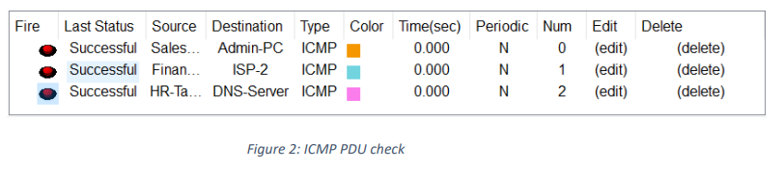
9. Testing & Validation
9.1 Simulation
Packet Tracer was utilized to simulate and test the designed network. Packet Tracer is a network simulation tool that provides a virtual environment for designing, configuring, and testing network scenarios. The simulation process involves:
Network Topology Design: The network topology, including routers, switches, PCs, servers, and other devices, was designed within Packet Tracer based on the specified requirements.
Configuration Implementation: Using the designed topology, configurations were implemented on routers, switches, and other network devices according to the provided guidelines. Cisco Packet Tracer allows users to configure devices with a user-friendly interface similar to actual Cisco devices.
Traffic Simulation: Packet Tracer allows the simulation of network traffic and communication between devices. This involves generating traffic, testing connectivity, and ensuring that data flows as expected.

Slide 16
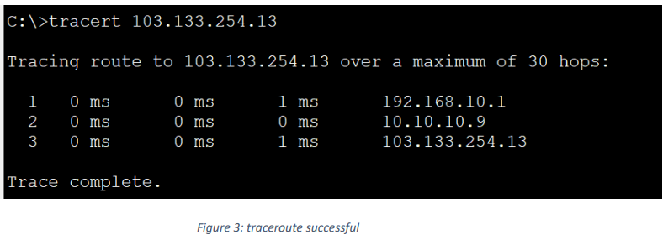
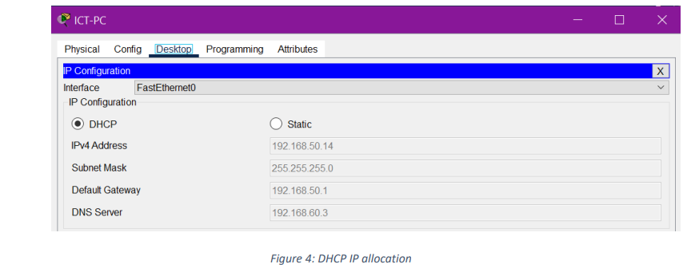
9.2 Testing & Validation
Verification of Redundancy and Failover
The hierarchical design with redundancy at every layer, including multiple routers, multilayer switches, and ISP connections, was tested to verify failover mechanisms and ensure network resilience.
DHCP and IP Address Allocation
Dynamic Host Configuration Protocol (DHCP) functionality and IP address allocation were tested to ensure that devices received the correct IP addresses dynamically and that devices in the server room had static IP assignments.

Slide 17
9.2 Troubleshooting
During the testing phase, several common troubleshooting steps were taken to address issues:
Device Connectivity:
Ensured that all devices could communicate within their respective VLANs and across different departments. Verified inter-VLAN routing configurations on multilayer switches.
DHCP Issues:
Investigated and resolved any DHCP-related issues, ensuring that DHCP servers were reachable and capable of assigning IP addresses to devices dynamically.
Routing Configuration:
Verified the Open Shortest Path First (OSPF) routing configurations on routers and multilayer switches, ensuring proper routing table updates and communication between different departments.
Access Control Issues:
Reviewed and adjusted Access Control Lists (ACLs) to allow necessary traffic and deny unauthorized access.
Port Security:
Verified the configuration of port security on the Finance department's switchports to ensure that only one device could connect per port and that MAC addresses were correctly learned

Slide 18
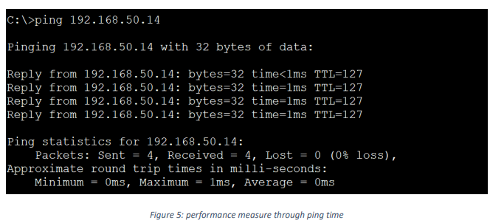
10. Results & Evaluation
10.1 Performance Metrics Performance metrics
, including network latency, throughput, redundancy testing, DHCP response time, inter-VLAN routing performance, security, QoS, and NAT/PAT functionality, were measured during testing to ensure optimal network operation

Slide 19
10. Results & Evaluation
10.2 Achievement of Objectives,
Hierarchical Network Design:
Successful implementation.
Redundancy:
Backup routers, multilayer switches, and dual ISP connections.
Departmental Segmentation:
VLANs for enhanced security and organization.
Inter-VLAN Routing:
Configured on multilayer switches.
Security Measures:
ACLs, port-security, SSH for access control.
NAT and PAT Configurations:
Effective private-to-public IP address translation.
Quality of Service (QoS):
Prioritization of voice and video traffic.
Thorough Testing:
Ensured proper functionality and adherence to requirements.
Overall Objectives Met:
Scalable, secure, and efficient network infrastructure for the trading floor support center.

Slide 20
11. Conclusion
11.1 Summary
In summary, the network design and implementation for the Company network design have been successfully executed. Key achievements include a hierarchical network model with redundancy at multiple layers, departmental segmentation through VLANs, inter-VLAN routing, robust security measures, effective NAT and PAT configurations, and Quality of Service (QoS) prioritization. Thorough testing using Cisco Packet Tracer ensured proper functionality and alignment with project requirements. The resulting network provides scalability, security, and efficiency, meeting the specified needs of the organization.
11.2 Lessons Learned
Redundancy is Key:
The inclusion of redundancy at various levels is crucial for maintaining network availability and minimizing downtime.
Effective VLAN Design:
Proper VLAN segmentation enhances security and facilitates organizational structure, simplifying network management.
Thorough Testing Matters:
Rigorous testing using simulation tools like Cisco Packet Tracer is essential to identify and rectify issues before deployment.
Security is a Priority:
Robust security measures, including ACLs and port-security, are fundamental in safeguarding the network against unauthorized access.
Scalability Considerations:
Designing the network with scalability in mind allows for future growth and expansion without significant overhauls.
Documentation is Essential:
Comprehensive documentation of configurations, IP addressing, and design decisions streamlines troubleshooting and future modifications.

Slide 21
12. Future Work
12.1 Potential Improvements:
Network Monitoring Tools
Enhanced Security Measures
Virtualization Technologies
Advanced Routing Protocols
IPv6 Implementation
Wireless Network Expansion
Cloud Integration
Ongoing Training and Skill Development
Energy Efficiency Measures

